Slide 1
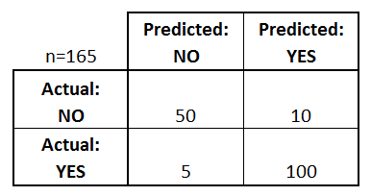
Confusion Matrix
A confusion matrix is a table that is often used to describe the performance of a classification model on a set of test data for which the true values are known.
Ex:
COVID – 19 - Binary prediction (Yes / No)
Total no. of Patient : 165
Real Data:
Covid Yes – 105 Patient
No Covid – 60 Patient
Our ML Predicted Data:
Covid Yes – 110 Patient
No Covid – 55 Patient

Slide 2
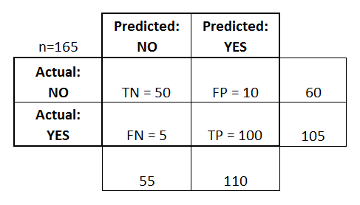
Confusion Matrix
True positives (TP): These are cases in which we predicted yes (they have the covid), and they have the covid.
True negatives (TN): We predicted no, and they don't have the covid.
False positives (FP): We predicted yes, but they don't actually have the covid. (Also known as a "Type I error.")
False negatives (FN): We predicted no, but they actually have the covid. (Also known as a "Type II error.")

Slide 3
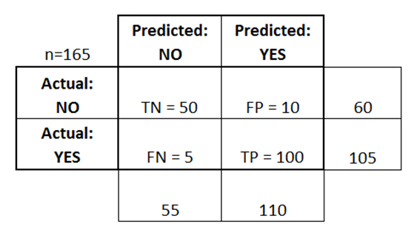
Accuracy & Loss Calculation from Confusion Matrix
Accuracy: Overall correct.
(TP+TN)/total = (100+50)/165 = 0.91
Misclassification Rate: Overall wrong | Error Rate
(FP+FN)/total = (10+5)/165 = 0.09

Slide 4
Other rates from Confusion Matrix
True Positive Rate: Sensitivity or Recall
TP/actual yes = 100/105 = 0.95
False Positive Rate:
FP/actual no = 10/60 = 0.17
True Negative Rate: Specificity
TN/actual no = 50/60 = 0.83
Precision:
TP/predicted yes = 100/110 = 0.91
Prevalence :
actual yes/total = 105/165 = 0.64

Slide 5
Feature extraction in Text - Methods
build_analyzer() - Return a callable that handles preprocessing, tokenization and n-grams generation.
build_preprocessor() - Return a function to preprocess the text before tokenization.
build_tokenizer() - Return a function that splits a string into a sequence of tokens.
decode(doc) - Decode the input into a string of unicode symbols.
fit(raw_documents[, y]) - Learn a vocabulary dictionary of all tokens in the raw documents.
fit_transform(raw_documents[, y]) - Learn the vocabulary dictionary and return document-term matrix.
get_feature_names() - Array mapping from feature integer indices to feature name.
get_params([deep]) - Get parameters for this estimator.
get_stop_words() - Build or fetch the effective stop words list.
inverse_transform(X) - Return terms per document with nonzero entries in X.
set_params(**params) - Set the parameters of this estimator.
transform(raw_documents) - Transform documents to document-term matrix.

Slide 6
CountVectorizer – Types of feature extraction in Text
Convert a collection of text documents to a matrix of token counts
HashingVectorizer – Types of feature extraction in Text
Convert a collection of text documents to a matrix of token occurrences

Slide 7
TfidfVectorizer – Types of Feature extraction in Text
Term-frequency times inverse document-frequency.
Convert a collection of raw documents to a matrix of TF-IDF features.
Equivalent to CountVectorizer followed by TfidfTransformer.
TfidfVectorizer. get_feature_names
DATA= [
'This is the first document.',
'This document is the second document.',
'And this is the third one.',
'Is this the first document?']
X = vectorizer.fit_transform(DATA)
TfidfVectorizer. get_feature_names
['and', 'document', 'first', 'is', 'one', 'second', 'the', 'third', 'this']

Slide 8
PassiveAggressiveClassifier - ML Algorithm
Passive-Aggressive algorithms are generally used for large-scale learning. It is one of the few ‘online-learning algorithms‘.
Data are Dynamic
max_iter : The maximum number of iterations the model makes over the training data.
Passive: If the prediction is correct, keep the model and do not make any changes. i.e., the data in the example is not enough to cause any changes in the model.
Aggressive: If the prediction is incorrect, make changes to the model. i.e., some change to the model, may correct it.

Slide 9
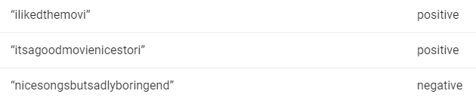
naive_bayes - MultinomialNB - ML Algorithm
Naive Bayes are mostly used in natural language processing (NLP) problems. Naive Bayes predict the tag of a text.
They calculate the probability of each tag for a given text and then output the tag with the highest one.
Bayes theorem calculates probability P(c|x) where c is the class of the possible outcomes and x is the given instance which has to be classified
Removing Stopwords: These are common words that don’t really add anything to the classification, such as an able, either, else, ever and so on.
Stemming: Stemming to take out the root of the word.

Slide 10
Workflow of Fake News Detection.
Loading Library & dataset
Visualizing & processing Dataset
Dataset Splitting as Train & Val
Applying Text feature extractor
Applying Ml Algorithm
Training ML Model
Test Trained Model from Val dataset
Confusion Matrix

Slide 11

Thanks!

